Slide 1
Analysis of Food and Beverage Industry Survey Data

Slide 2
Objective
The objective of this Power BI project is to analyze survey responses from the food and beverage industry to gain insights into consumer behavior, preferences, and perceptions.
The analysis helped to identify key trends, understand brand perception, and explore potential areas for improvement in product offerings and marketing strategies.

Slide 3
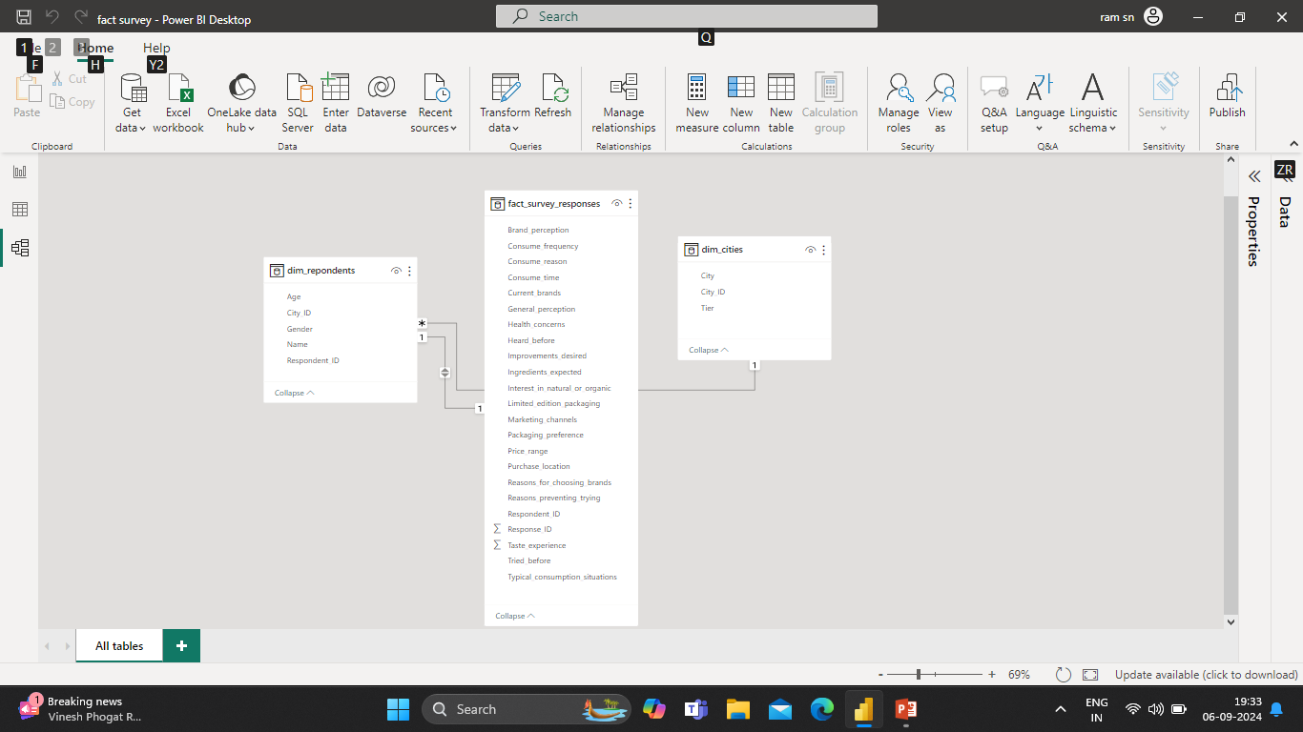
Schema used

Slide 4
Fact Table: fact_survey_responses
Response_ID: Unique identifier for each survey response.
Respondent_ID: Unique identifier for each respondent.
Consume_frequency: Frequency of consumption of food and beverage products.
Consume_time: Typical time when the products are consumed.
Consume_reason: Reasons for consuming the products.
Heard_before: Whether the respondent has heard of the product before.
Brand_perception: Respondent's perception of the brand.
General_perception: Overall perception of the food and beverage industry.
Tried_before: Whether the respondent has tried the product before.
Taste_experience: Respondent's experience with the taste of the product.
Reasons_preventing_trying: Reasons preventing respondents from trying the product.
Current_brands: Brands currently consumed by the respondent.
Reasons_for_choosing_brands: Reasons for choosing specific brands.
Marketing_channels: Preferred marketing channels for product information.

Slide 5
Improvements_desired: Improvements desired in products.
Ingredients_expected: Expected ingredients in products.
Health_concerns: Health concerns related to products.
Interest_in_natural_or_organic: Interest in natural or organic products.
Packaging_preference: Preferences for product packaging.
Limited_edition_packaging: Interest in limited edition packaging.
Price_range: Preferred price range for products.
Purchase_location: Typical locations where products are purchased.
Typical_consumption_situations: Common situations in which products are consumed.

Slide 6
Dimension Table: dim_respondent
Respondent_ID: Unique identifier for each respondent.
Name: Name of the respondent.
Age: Age of the respondent.
Gender: Gender of the respondent.
City_ID: Identifier linking the respondent to a city.
Dimension Table: dim_cities
City_ID: Unique identifier for each city.
City: Name of the city.
Tier: Tier classification of the city (e.g., Tier 1, Tier 2).

Slide 7








Demography of Respondents
Ahme…
City
Gender
Count of Nam

Banga…
Ahmedabad
Female
16
Ahmedabad
Male
25
Chennai
>
Ahmedabad
Non-binary
3
Bangalore
Female
91
Bangalore
Male
176
Delhi
Bangalore
Non-binary
12
Number of Respondents
Max Respondents
Min Respondents
Chennai
Female
33
Chennai
Male
56
0.51K (5.07%)
6K
Chennai
Non-binary
3
5.5K
Delhi
Female
14
Delhi
Male
25
3.46K (34.55%)
4K
Delhi
Non-binary
2
2.4K
Hyderabad
Female
66
6.04K (60.38%)
2K
1.5K
Hyderabad
Male
107
Hyderabad
Non-binary
8
0.4K
0.2K
Jaipur
Female
11
Gender
Male
Female
Non-binary
0K
19-30
31-45
15-18
46-65
65+
Jaipur
Male
22
Jaipur
Non-binary
2
Kolkata
Female
19
3K
2.8K
8K
Kolkata
Male
35
1.5K
1.8K
0.9K
2.8K
Kolkata
Non-binary
2
6K
Lucknow
Female
6
2K
1.8K
Lucknow
Male
9
1.5K
4K
Lucknow
Non-binary
1
0.9K 0.9K
Mumbai
Female
52
1K
0.6K _{0.5K 0.4K}
Mumbai
Male
88
0.4K _{0.2K}
2K
0.9K
Mumbai
Non-binary
9
0K
0.6K
Pune
Female
32
Pune
Delhi
Jaipur
0K
Pune
Male
51
Bangalo…
Mumbai
Chennai
Kolkata
Lucknow
Tier 1 Tier 2
Bangalore Chennai Delhi Hyderab…
Pune
Non-binary
6
Hyderabad
Ahmedabad
City
Ahmeda…
Jaipur
Kolkata
Total
948

Slide 8
Respondents Buying Behavior
Count of Purchase_location
Popular Marketing_channel
Preferred Packaging
Preferred Purchase_location
77
2-3 tim…
174
213
200
178
45
Rarely
Daily
Once a … 2-3 tim…
97
200
110
119
73
100
77
45
100
70
67
34
45
110
72
0
Supermar…
Other
0
63
Online ret…
Gyms and …
Local stores
Incre… To To To energ… comb… boost… enha…
Other
34
Current_brand
s
Reasons_for_choosing_brands
Responses
Reasons_preventing_trying
 Bepsi
 Blue Bull
 CodeX
 Cola-Coka
Count of Respondent_I
Availability | 86
Brand reputation | 140
Effectiveness | 87
Other | 79
Taste/flavor preference | 87
Health concerns
10
213
Not available locally
10
Yes
310
Not interested in energy drinks
11
No
169
Other
5
34 (7…)
143
(29.85%)
Unfamiliar with the brand
9
0
200
Ahmedabad | Delhi | Kolkata
108 (22.55%)
272
194 (40.5%)
207
26
24
Bangalore | Hyderabad | Lucknow
200
(5.…)
(5.…)
>
135
(28.18%)
Chennai | Jaipur | Mumbai
177 (36.95%)
Limited_edi…
No Yes Not Sure
0
No
Yes
Cons…
To stay a…
Before ex…

Slide 9
Brand Perception
Bepsi
Blue Bull
CodeX
Cola-Coka
>
3.0K
Online ads
TV commercials Outdoor billbo…
Other Print media
4.0K
2.5K
2.7K
2.0K
2K
1.5K
Count of Current_brands
1.2K
1.2K
1.0K
0.8K
0K
0K
1K
2K
3K
4K
Reduced sugar content
More natural ingredients
Wider range of flavors
Healthier alternatives
Other
Popular Brand
Brand_perception 100-150 50-99 Above 150 Below 50
Total
Caffeine
Vitamins
Guarana
Negative | 551 | 796 | 260 | 162 | 1769
Neutral | 1878 | 2552 | 932 | 612 | 5974
Positive | 713 | 940 | 369 | 235 | 2257
Total | 3142 | 4288 | 1561 | 1009 | 10000
Heard_before
Count of Respondent_ID
No
V
5553
2.53K
Yes
4447
Sugar
Total
10000
3.90K
2.02K
1.55K
Brand_perception
Negative
Neutral
Positive
1535
1,500
1281
1097
1,000
574
440
587
589
591
500
429
391
320
437
294
204
267
172
219
176
212
77
108
0
Cola-Coka
Bepsi
Gangster
Blue Bull
CodeX
Sky 9
Others

Slide 10
Insights from the analysis
Compact and Portable cans are highly preferred packaging materials
Supermarkets and online ads need to increase to enhance the sale
The respondents are highly concerned about the health
Caffeine is highly desired by the respondents
Brand awareness has to be created using various marketing channels mainly online ads as it has high reach
Sugar content need to be reduced in the beverages

Slide 11
Thank you

